Slide 1
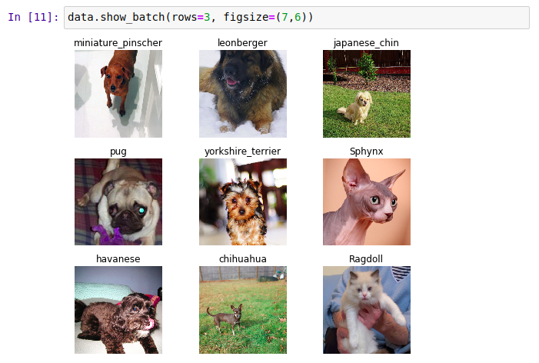
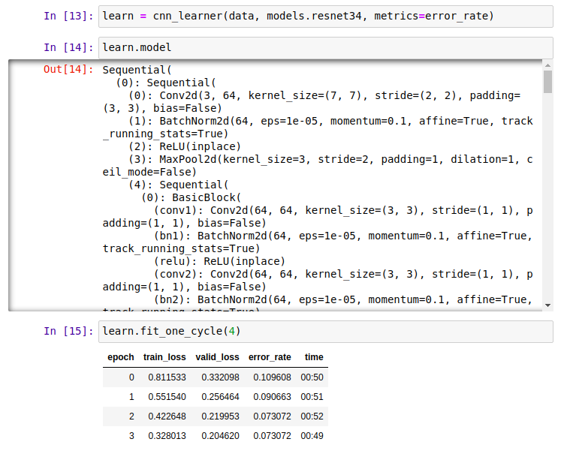
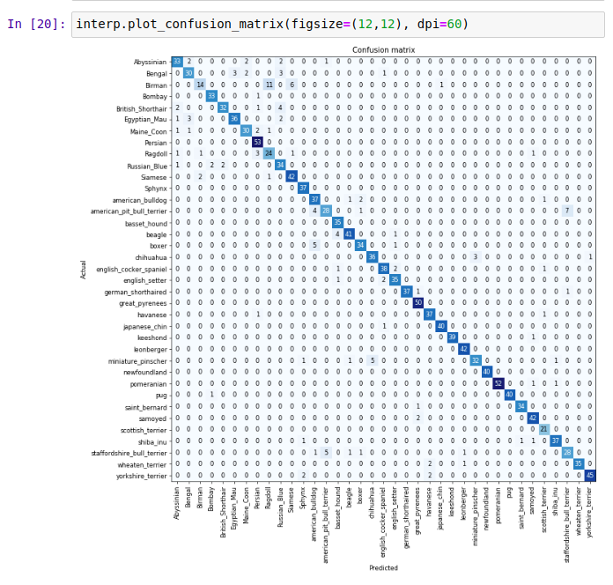

fast.ai
Making neural nets
uncool again
Josiah Laivins
February 23, 2020
(1)
Notes:
- intro about me
- fastai why did I choose
- Used by mariner

Slide 2
Black Box
Interpretable ML
Visualize Gradients and activations
Needs too much data
Transfer learning
Share pre-trained nets
Needs ML PhD
No longer true
Fastai & keras libs MOOCs, etc
Only for vision
No longer true
SoTA for speech, structured data, time series...
Needs lots of GPUS
Was never true
… except for some research projects
"Not really AI"
Who cares
Do you really want to build a brain
Description from: https://course.fast.ai/videos/?lesson=1
(2)

Slide 3
Making Deep Learning Accessible
Software
To make these available to use quickly, reliably, and with minimal code
Community
So that we can all help each other
Research
Ways to make state of the art deep learning techniques more accessible
Research
So that as many people as possible use these
Description from: https://course.fast.ai/videos/?lesson=1
(3)
Notes:
What is Fastai?
- A frame work for deep learning and machine learning using a mml lib called pytorch
- chose python for its simplicity and similarity to research paper math
What are all the benefits of fastai?
- pipelineing
- training
- inference
- cleanign data
Why would you use this over another framework?
- if you don't know anything about ML
- replace this slide with something that talks more about what use fastai?
- for biginners?
- for advanced?

Slide 4




What is fastai?
Popular ML library
One of the most popular programming languages
Different from classical programming. "friendlier".
[1] https://pytorch.org/
[2] https://python.org/
[3] https://jupyter.org/
(4)

Slide 5
DataBunch
Images, text, audio
Data transformation
Data analysis
Model
Neural net being trained
Atomic and portable
DataBunch
Learner
Model
Interpretation
Learner
Contains everything
Says how and when things should happen
Interpretation
Post training quick analysis of model performance, troubleshooting
(6)

Slide 6
Who is fastai for?
Newbie's
Tied to a course for anybody to learn from
No math required to get into ML
Jupyter notebooks are far friendlier than most IDEs
Experienced Data Scientists
Existing API code for pipelining
Easy comparison between other models
Attached course goes into detailed topics
Established codebase to build on top of
Description from: https://course.fast.ai/videos/?lesson=1
(5)

Slide 7
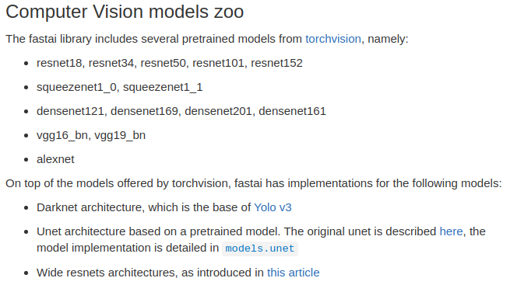
fastai
vision models
[1] https://docs.fast.ai/vision.models.html
(7)
Notes:
Still generally talking about what fastai is, what is has

Slide 8
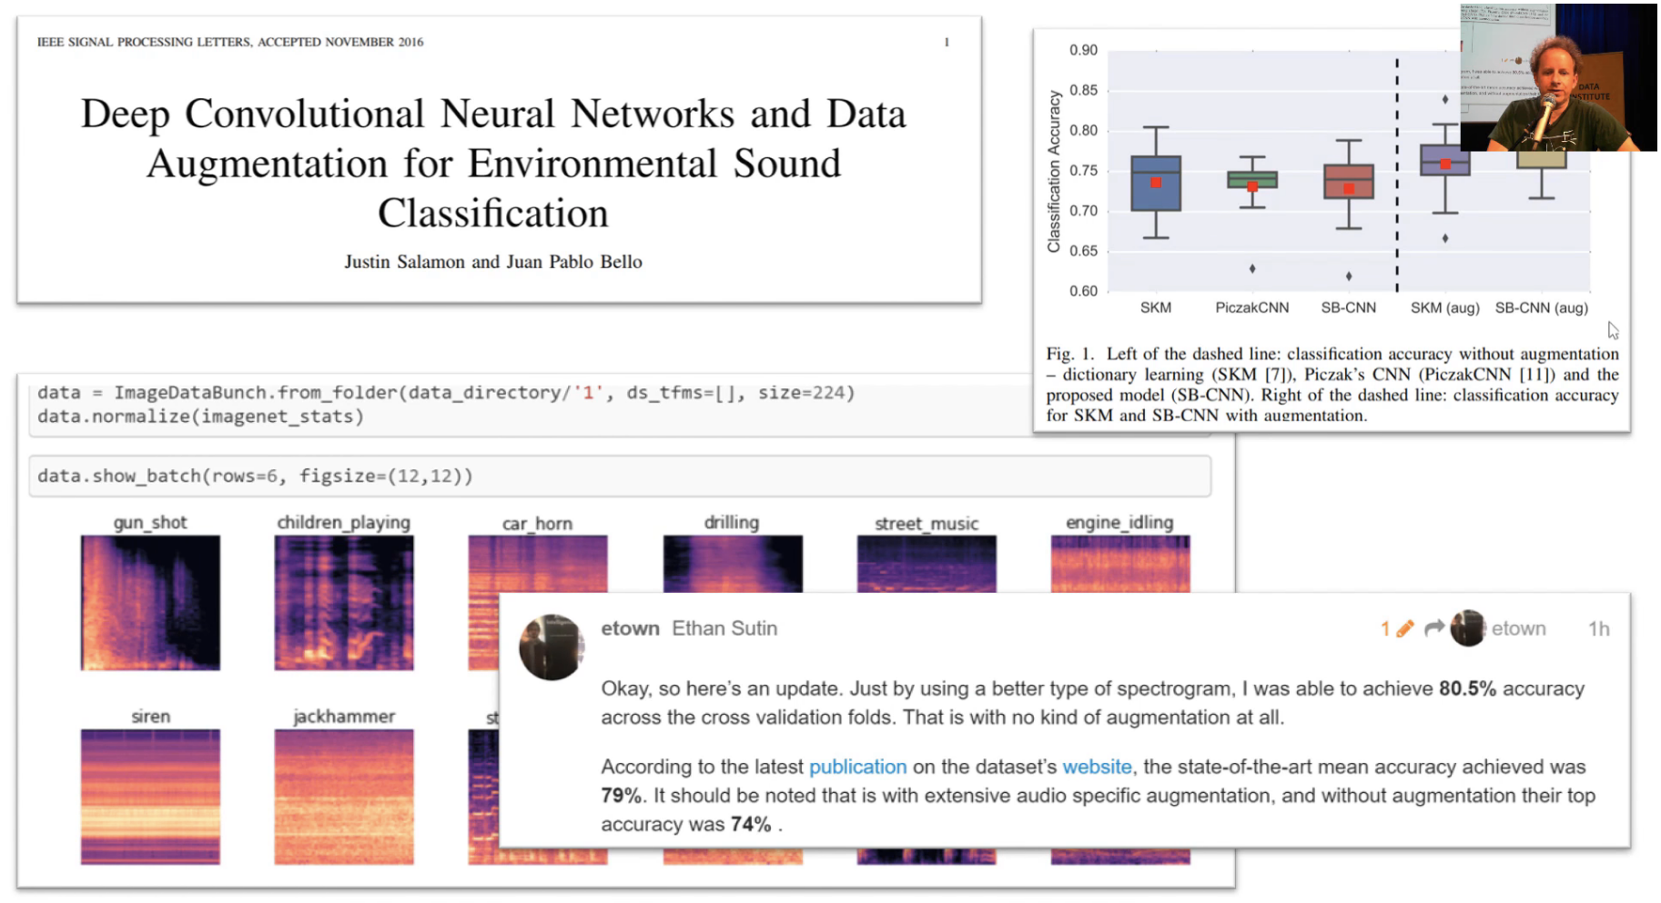
[1]: https://github.com/hiromis/notes/blob/master/Lesson2.md
[2]: https://forums.fast.ai/t/share-your-work-here/27676/215
(8)

Slide 9
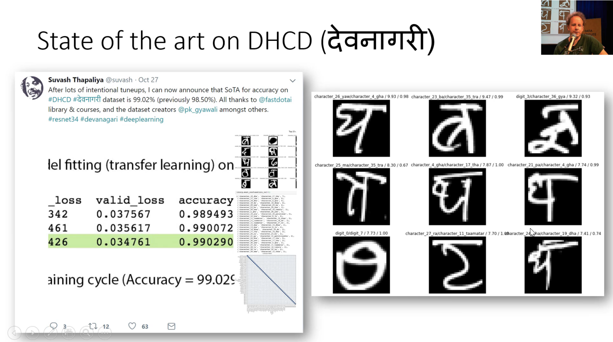
[1]: https://github.com/hiromis/notes/blob/master/Lesson2.md
[2]: https://forums.fast.ai/t/share-your-work-here/27676/38
(9)

Slide 10
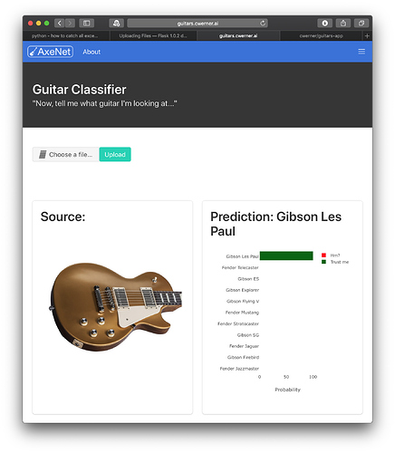
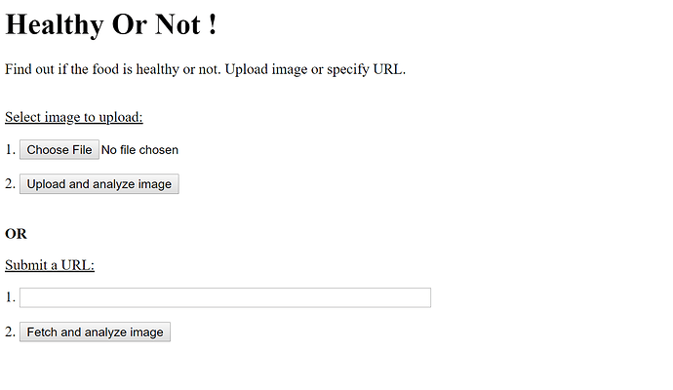
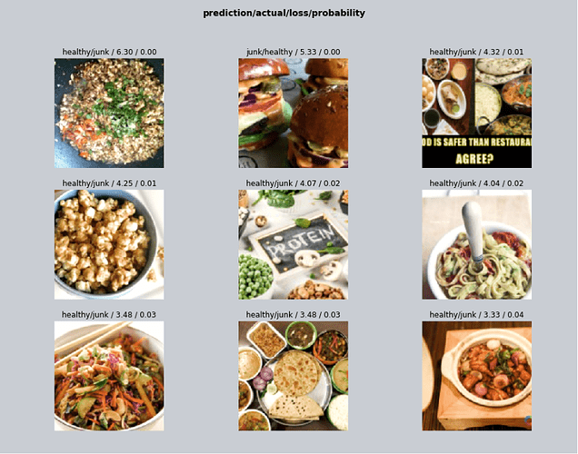
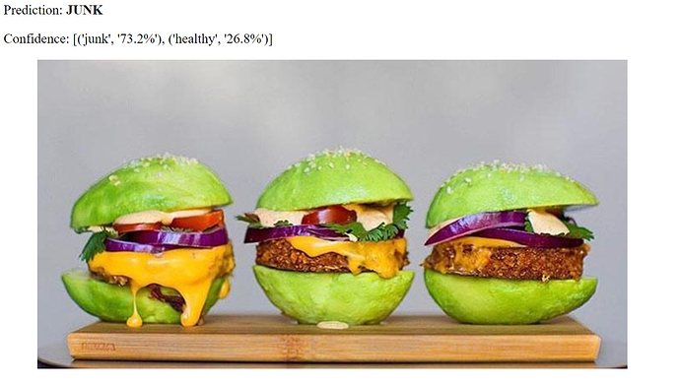
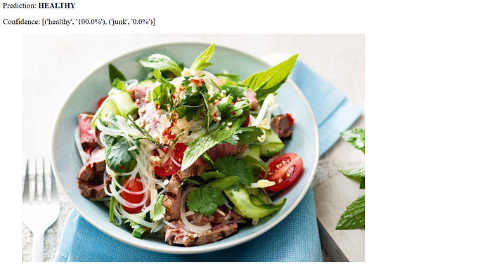
Guitar Classifier
Junk or Health Food Classifier
[1]: https://github.com/hiromis/notes/blob/master/Lesson3.md
[2]: https://forums.fast.ai/t/share-your-work-here/27676/399
[2]: https://forums.fast.ai/t/share-your-work-here/27676/340
(10)

Slide 11
fast.ai not just classification
(11)

Slide 12
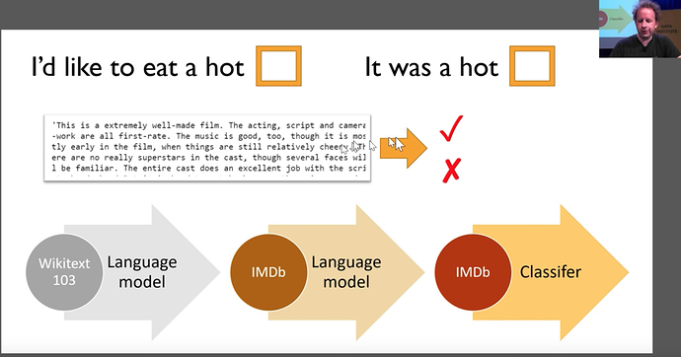
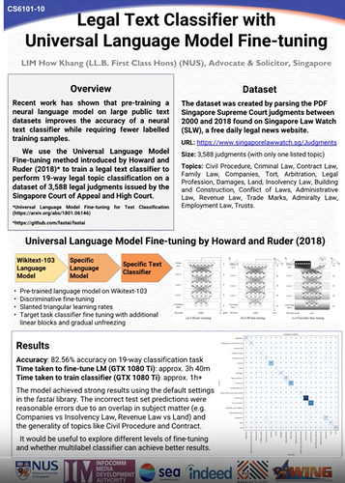
NLP
Movie Review Sentiment Classification
Legal Document Classification
[1]: https://forums.fast.ai/t/deep-learning-lesson-4-notes/30983
(11)

Slide 13
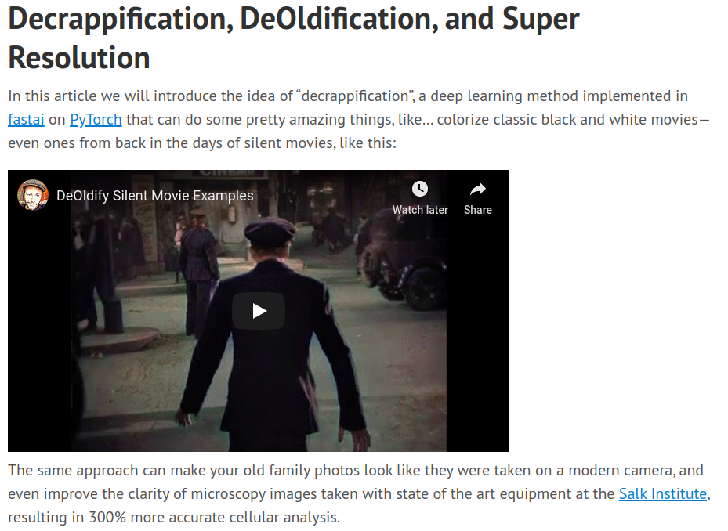
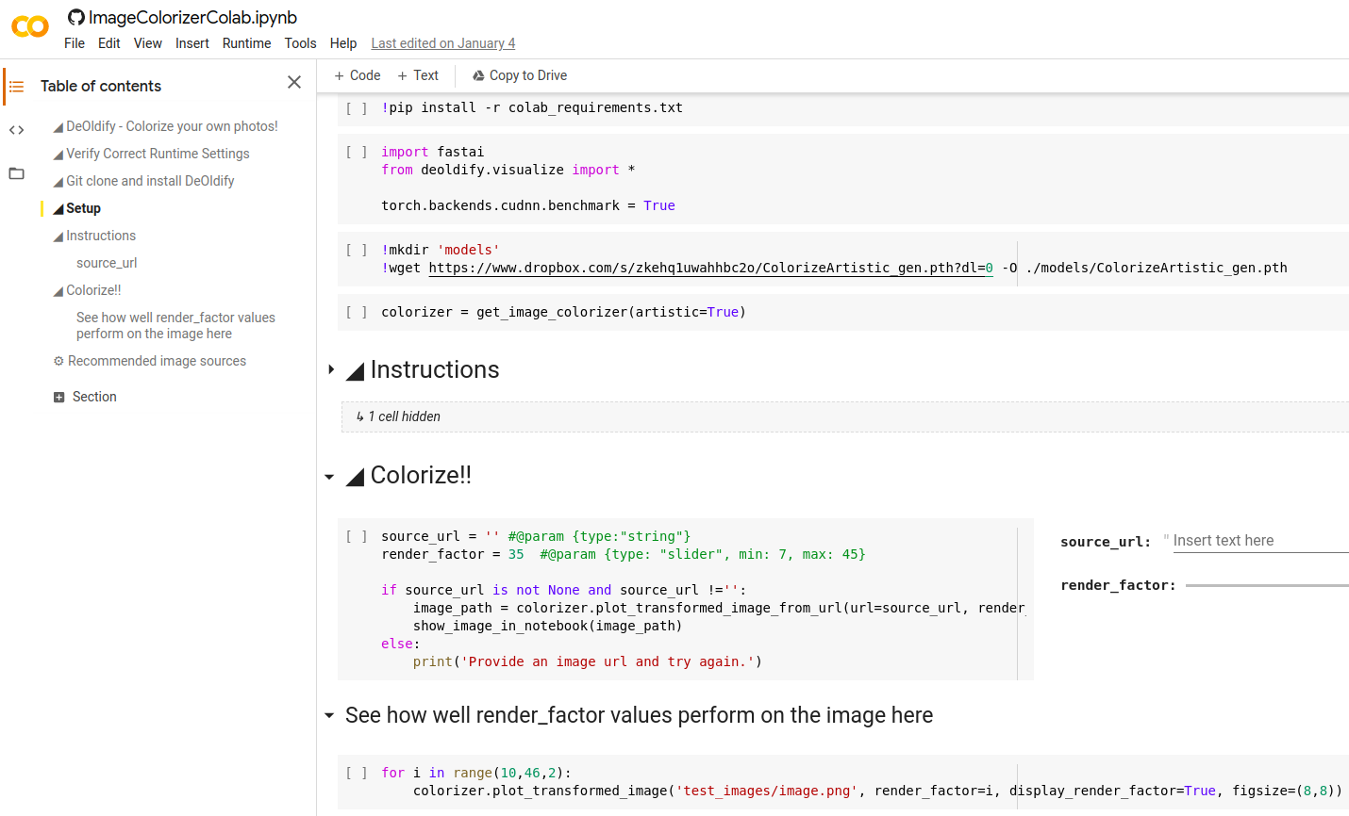
GANs
DeOldify
Colorizer
[1]: https://www.fast.ai/2019/05/03/decrappify/
[2]: https://colab.research.google.com/github/jantic/DeOldify/blob/master/ImageColorizerColab.ipynb#scrollTo=LHfUPH42O_iK
(1
2)

Slide 14
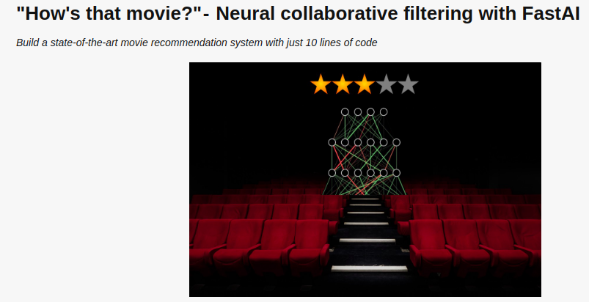
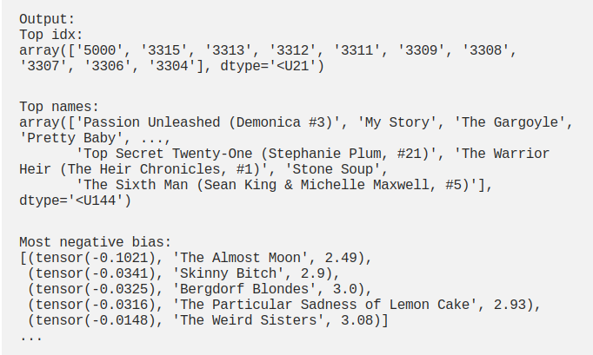
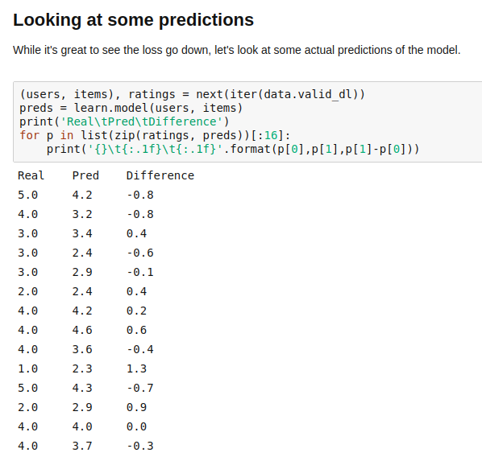
Collaborative Filtering
Movie Recommendation System
Book Recommendation System
[1]: https://course.fast.ai/videos/?lesson=4
[2]: https://towardsdatascience.com/collaborative-filtering-with-fastai-3dbdd4ef4f00
[3]: https://jovian.ml/aakashns/5bc23520933b4cc187cfe18e5dd7e2ed
(14)

Slide 15
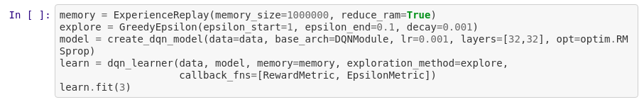
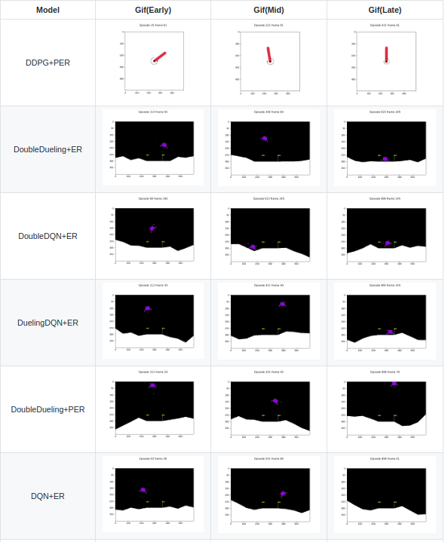
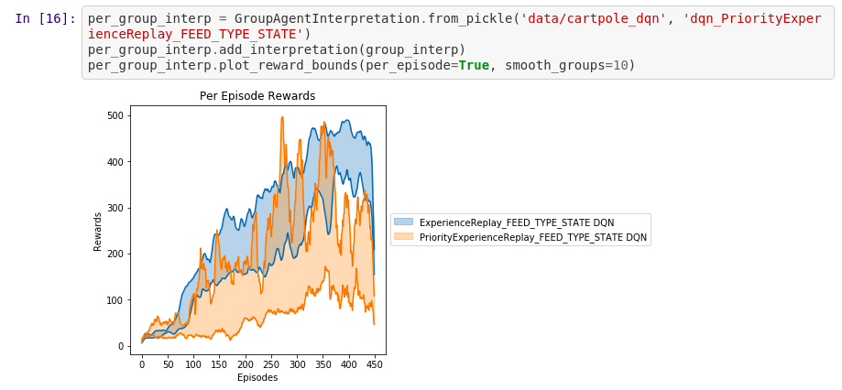
Reinforcement Learning (experimental)
[1]: https://github.com/josiahls/fast-reinforcement-learning
(15)

Slide 16
Now to coding
(16)
Notes:
Ok lets get to making a simple model.
So as first impression, how many people have used jupyter notebooks? Doesn’t look like real programming does it? We have both actual text with code in the same file. If you go the github, you will see that it even renders. These notebooks are awesome of testing new things, and documenting what you did as you go.
Note this is a heavily modified version of the fastai lesson 1 notebook, and I recommend that you do the lesson 1 course because Jeremy Howard does a better job at explaining this than me.
Don’t worry about these 3 lines of code. They are important if you are changing the original files, this notebook need to update itself.
So the first thing we need to do is import the fastai code. Fastai has different code for different deep learning problems. They have also spreadsheet code and natural language learning code.
This line is the batch size. This can determine how well your model learns, however depending on you computer, you will likely need to make the size small anough to be used by your computer.
Fastai has a lot of useful functions, untar_data makes it easy to download and unpack large datasets. You can see all the dataset you can download here (the URLs link). You can also try a custom dataset url and see if that works. If neither of those work for you, you might need to download it manually, then set the path variable to the location to your data.
MNIST is a large dataset of hand written numbers 0 to 9. It is exetremely popular for is pretty to test new models on before mvoing to more complex datasets.
This is the ImageDataBunch. It is as it says, a bunch of images. It is in charge of importing, transforming, resizing, and analyzing the data. They also have TabularDataBunch for spread sheet, csv data, TextLMDataBunch for language models, TextClasDataBunch for text classification.
So in order to import this data, we pass the path to the data, and the size of the expected image. If you make the size smaller, then it will automatically resize the images.
Next, lets look at the data we have imported. Show_batch makes this super easy. We are working with 2 classes 3s and 7s and the goal is for our model to use the pixels to learn the difference between the 2.

Slide 17
fast.ai has a MOOC!
(17)

Slide 18
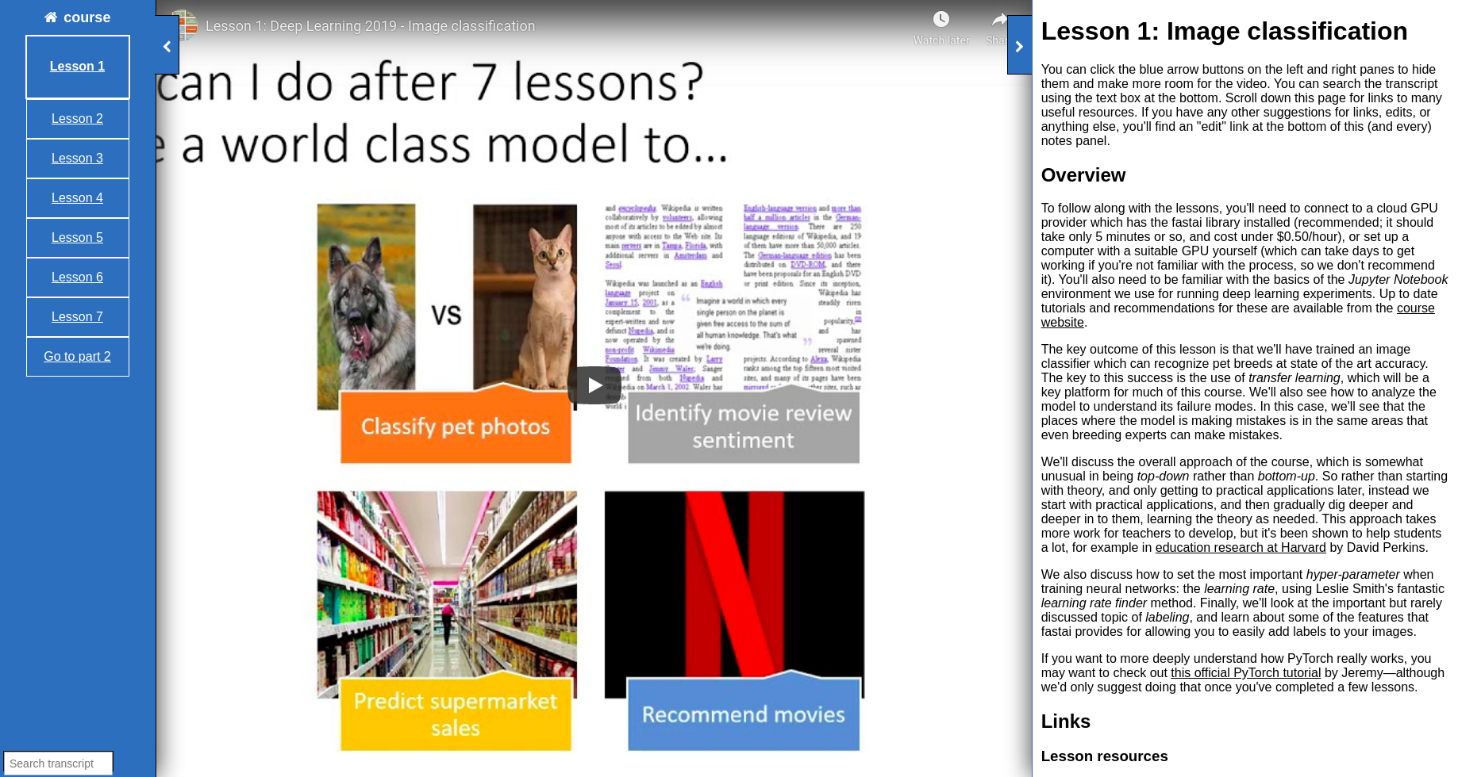
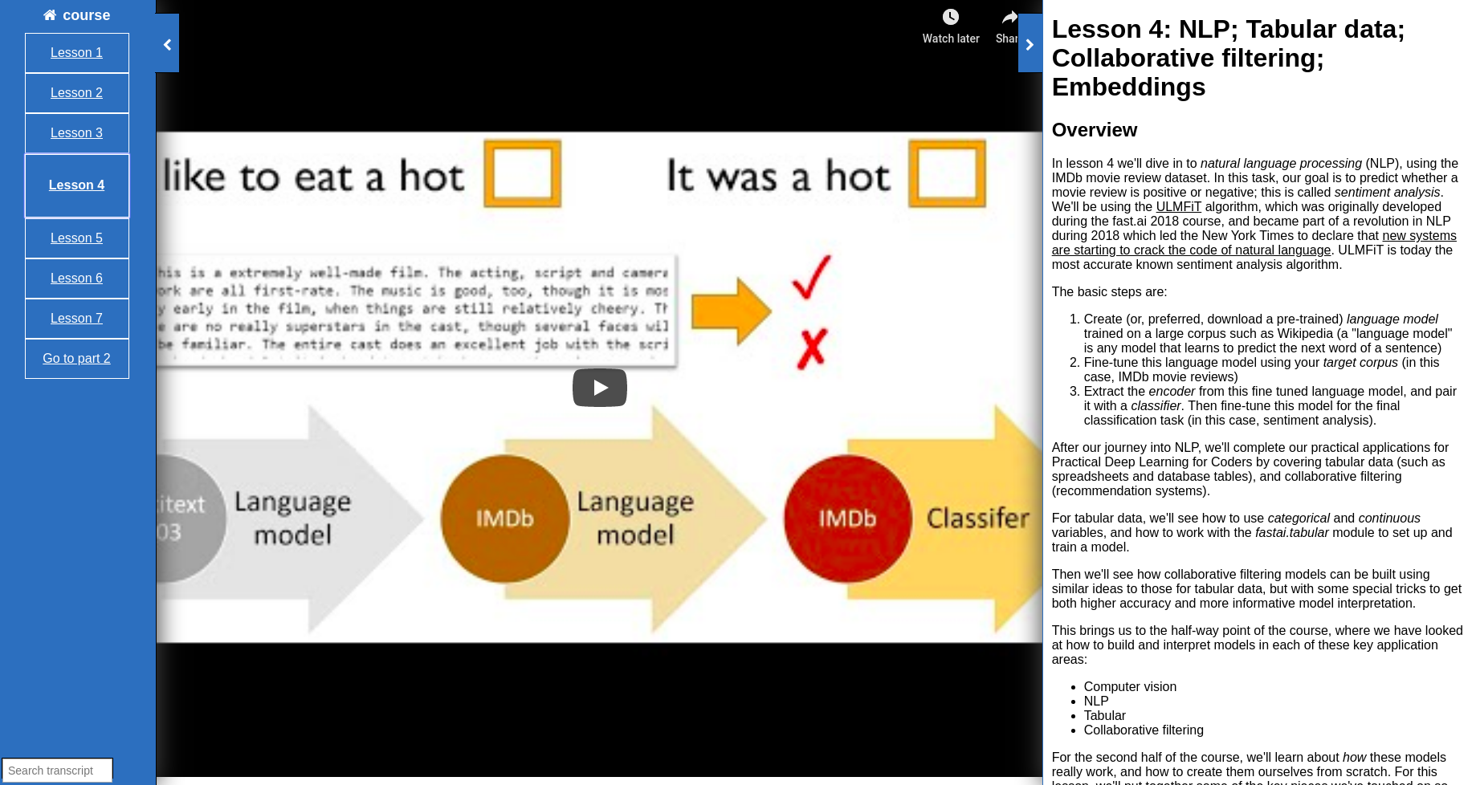
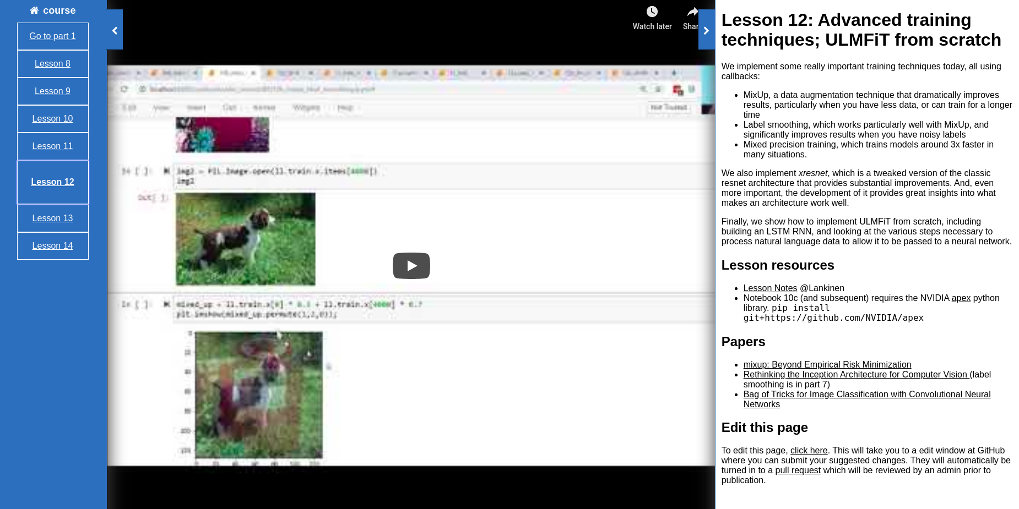
[1]: https://course.fast.ai/videos/?lesson=1
(18)

Slide 19
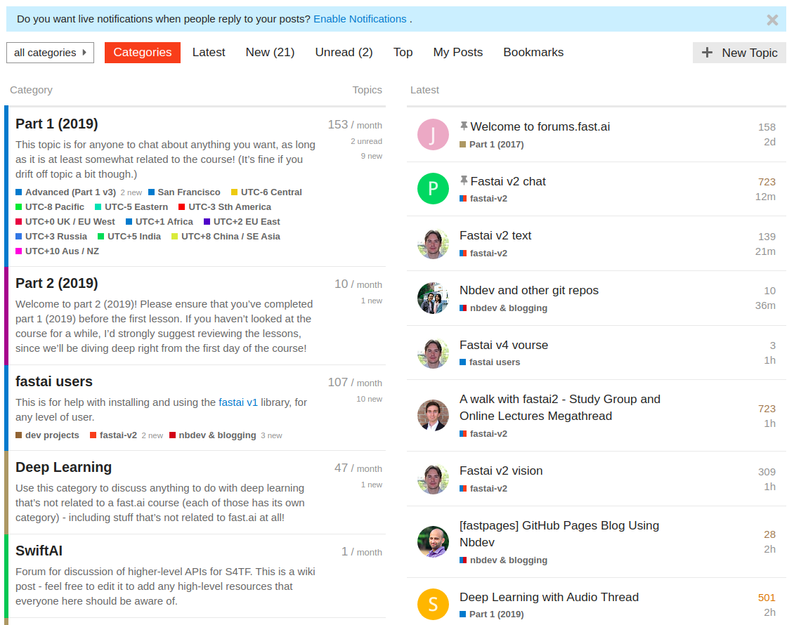
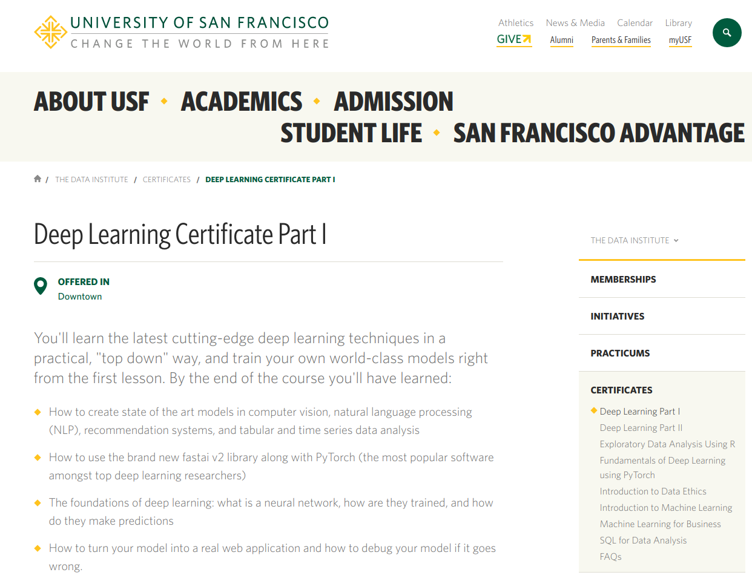
[1]: https://forums.fast.ai/
[2]: https://www.usfca.edu/data-institute/certificates/deep-learning-part-one
(19)

Slide 20
*From Stephen Welch's 2/7/2020 CAIR presentation
1. Form a fastai study group, contribute to the fastai library
2. Making kick-ass RL tools, push RL research forward– work with Josiah on fastrl!
3. Unsupervised & one-class learning in manufacturing on the MVTech dataset. [Stephen] I’m personally offering a $250 bounty on this.
4. Open problem in manufacturing and autonomous driving – supervised model health monitoring
- how do we know when a model is no longer performing well without labeling new data?
5. Create a CAIR Kaggle Team
6. Amazon DeepRacer team – I believe Dr. Shin is forming a team
7. Create high quality educational AI resources (videos, blogs, books)- happy to help as I have time.
8. Summer internship working with Stephen Welch & Josiah at Mariner
9. Summer internship at Atrium working on AI for medical applications
(20)

Slide 21
Thank you!
(21)

